Slide 1

Factors influencing Olympics Performance
Peregrin Ryan
Anam Khalid
Prathima
Zitarashe Okot
p

Slide 2




Introduction
According to nbc sports, USA, Russia, Germany, Great Britain and France are the top performers in Olympics. We used various methods to find out the measurable factors that contributes to the success of a country in Olympic games!

Slide 3
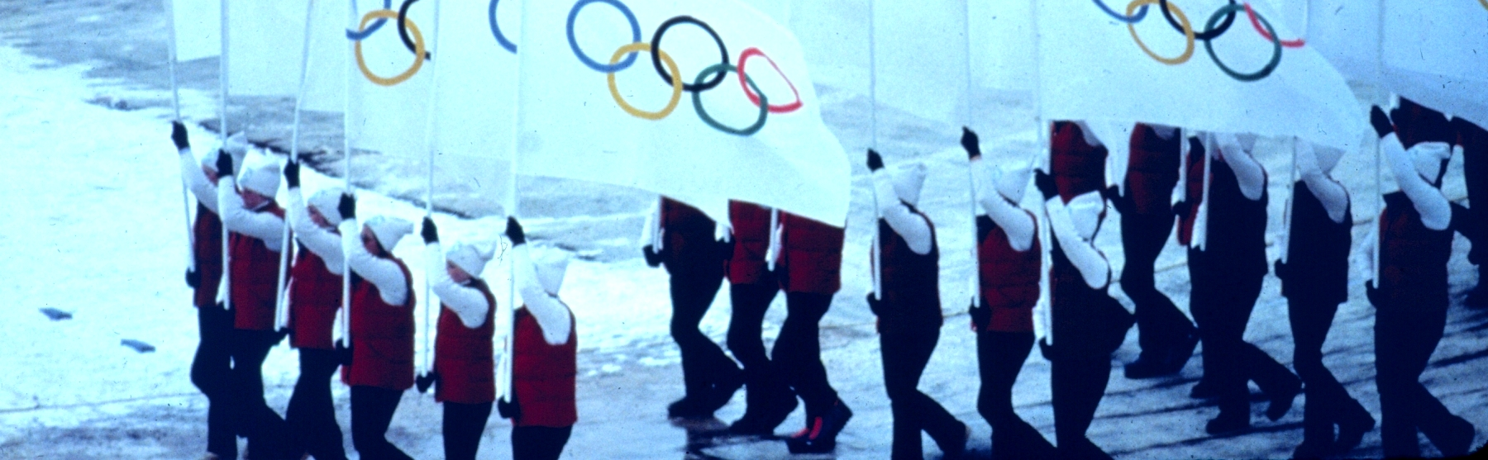
Agenda
How does population size affect countries success in winning the Olympic Games?
What is the relationship between GDP and Olympic medals?

Slide 4

Hypothesis
Our hypothesis was to investigate how measurable global factors affect success of countries in the Olympic games.
We believed that countries with larger GDP and population would have more success in the Olympic games.

Slide 5

What is GDP ?
(Gross Domestic Production)
How did we measure success in the Olympic games?
How did we measure population
And we had measures medals
Population in thousands from 2017
winter and summer Olympic games.

Slide 6
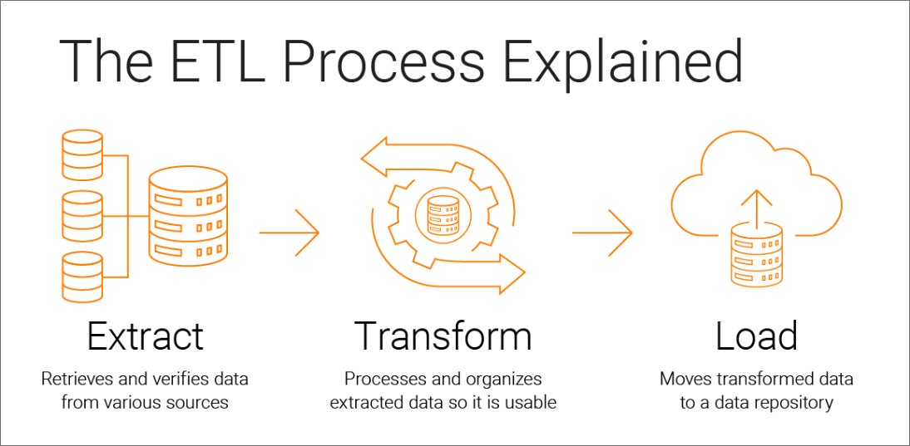
ETL Pipeline Using SQL Database
Libraries used
pandas
sqlalchemy
config
Steps involved
Extract
Transform
Load

Slide 7
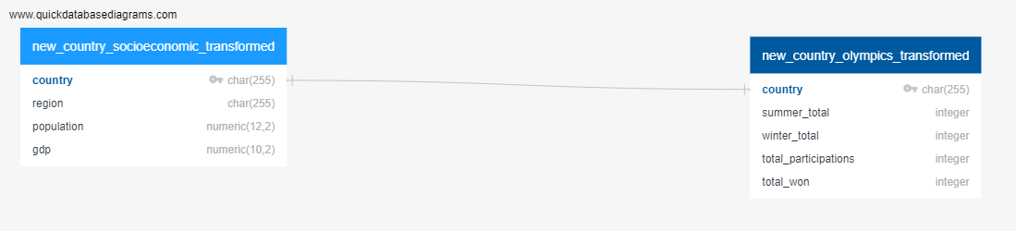
ER Diagram

Slide 8
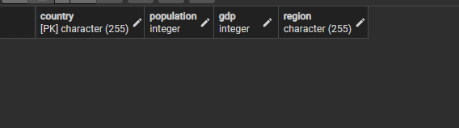
Prepare Your Database
Create tables for datasets in the olympics database
country_socioeconomic
country_olympics
Primary key
country
Select and inner join the tables
Note: The tables created doesn’t have data at this stage.

Slide 9
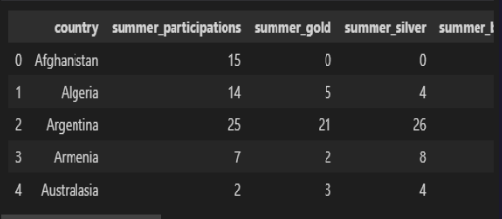
Extract
Read the data using pandas library and display the dataframes

Slide 10
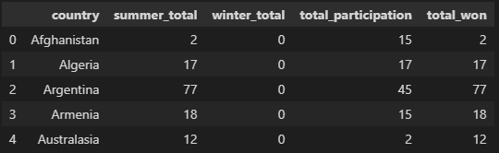
Transform
Create a copy of the filtered dataframes from specific columns
Rename the column headers
Clean the data by dropping duplicates and NA values if any
Display the new dataframes

Slide 11
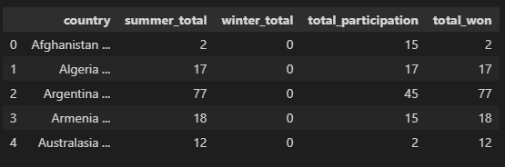
Load
Connect with the local database
Inspect tables
Load the data into the database by using .to_sql method
Query both tables to confirm if the data has been added

Slide 12
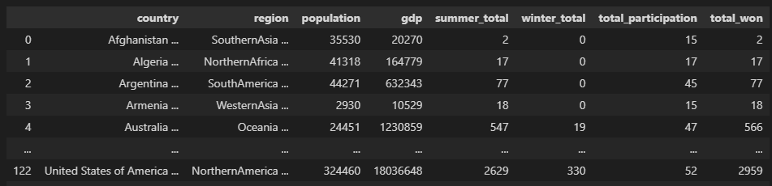
Join and Preview
Time to inner join in pandas
Preview the sql database

Slide 13

Web Scraping - How did we get the Data?
DATA

Slide 14





Web Scraping - How did we get the Data?

Slide 15
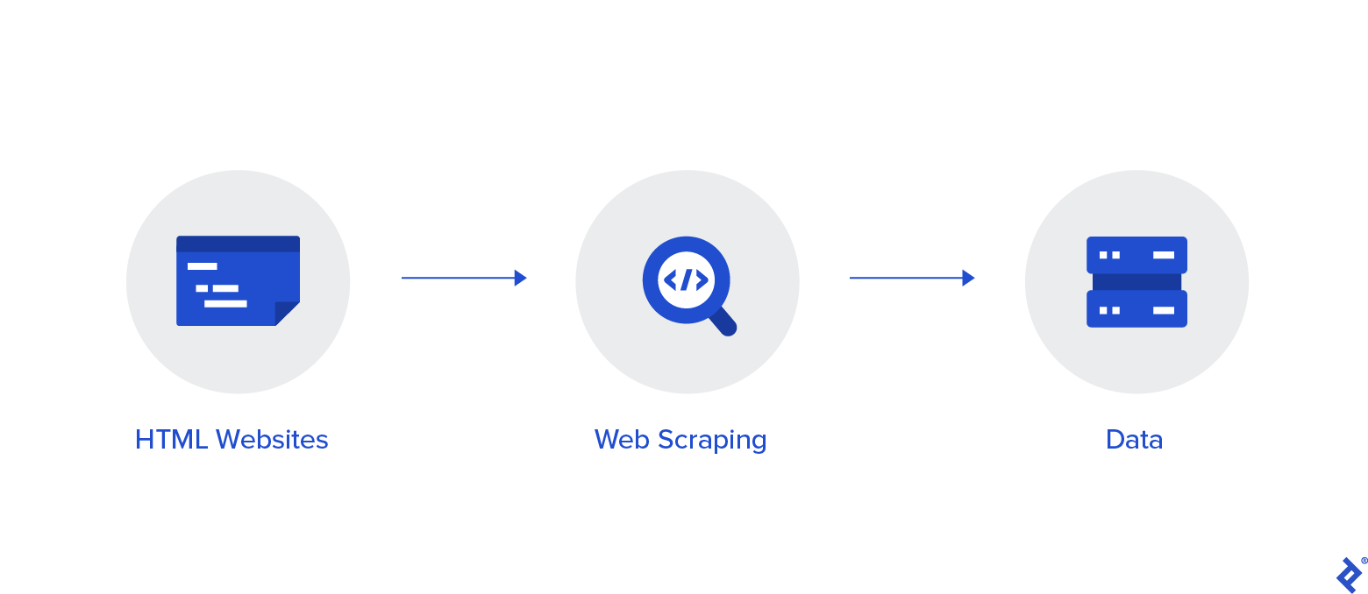
What was the process?

Slide 16


What was the process?

Slide 17
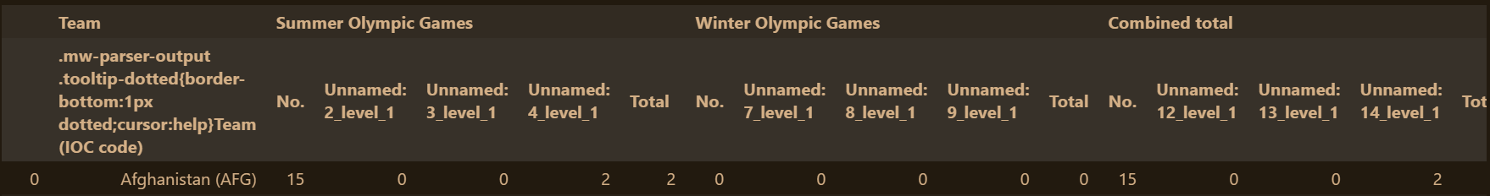
Cleaning the data - What are the problems?
The two headers that don't make sense
Too many columns
Country Codes

Slide 18

The Headers
To CSV :
Header = False
Read CSV :
With Custom Header
Scraped DataFrame
Temp .CSV
New DataFrame

Slide 19

The Headers
To CSV :
Header = False
Read CSV :
With Custom Header
Scraped DataFrame
Temp .CSV
New DataFrame
DELETE Temp.CSV

Slide 20
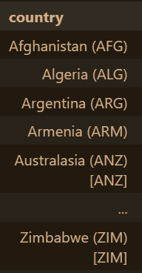
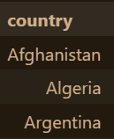
Finishing the cleaning
New DataFrame
Delete “(“ and everything to the Right
New Headers

Slide 21


Flask

Slide 22



Database Retrieval
Database
Psycopg2
Json Dump

Slide 23





Flask Server Structure
JSON To API
Index.html
Visualisations

Slide 24

Visualisations
What is the story of the data?

Slide 25
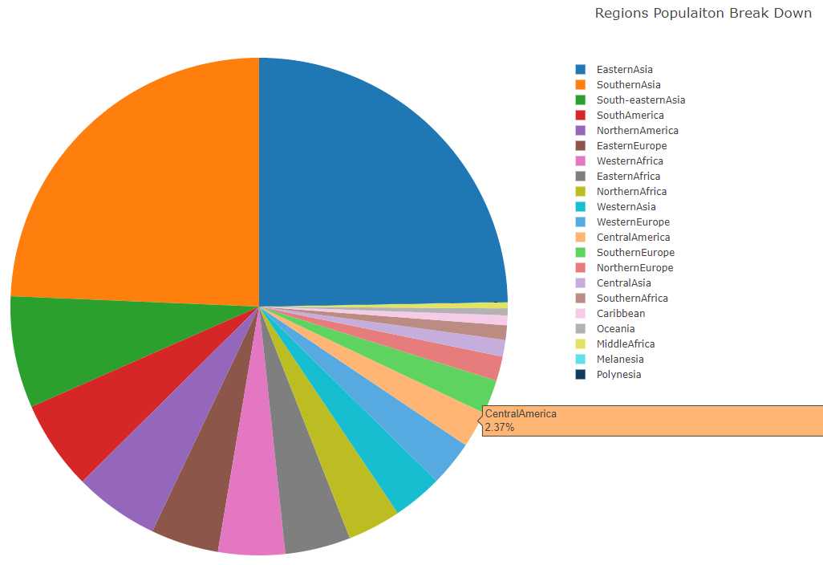
Regional Data - Pie Charts: Population

Slide 26
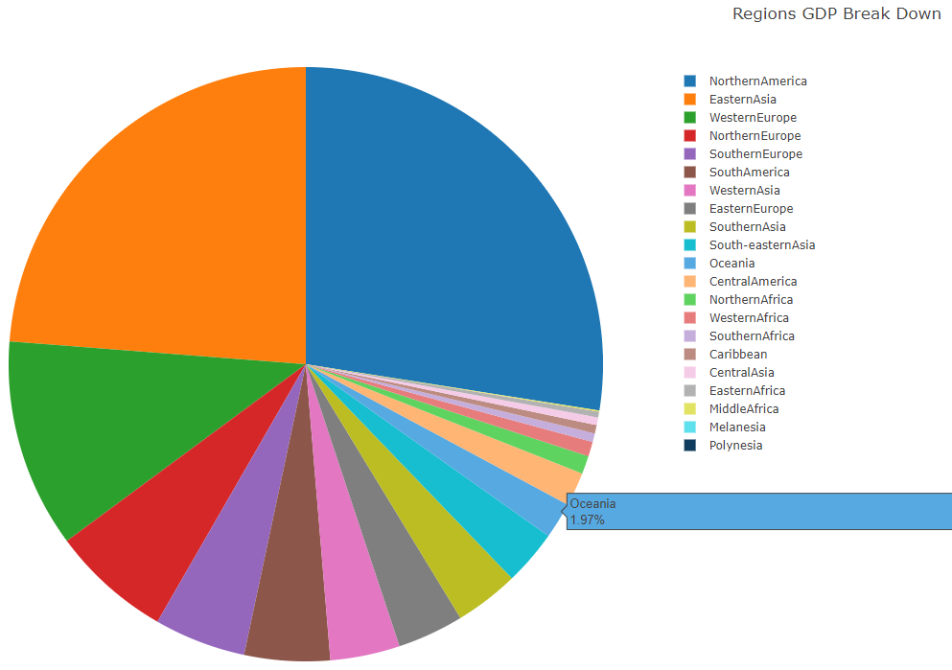
Regional Data - Pie Charts: GDP

Slide 27
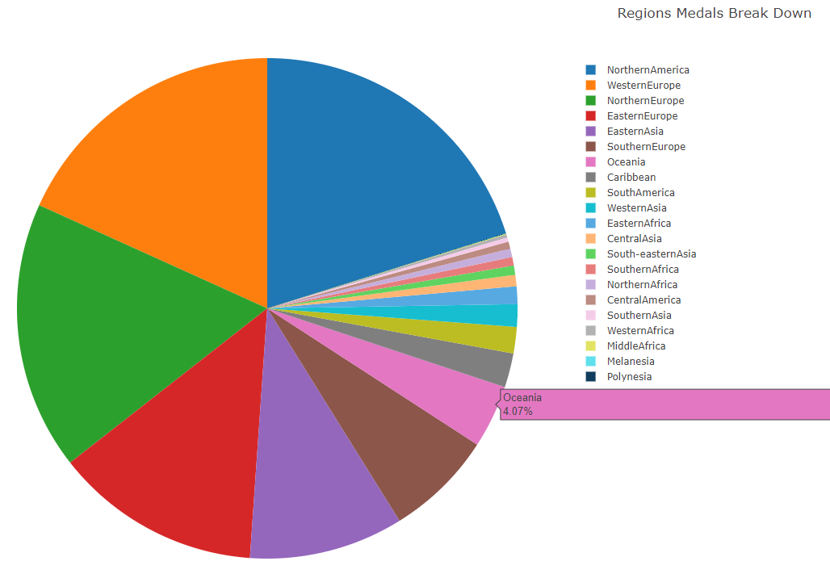
Regional Data - Pie Charts: Medals

Slide 28
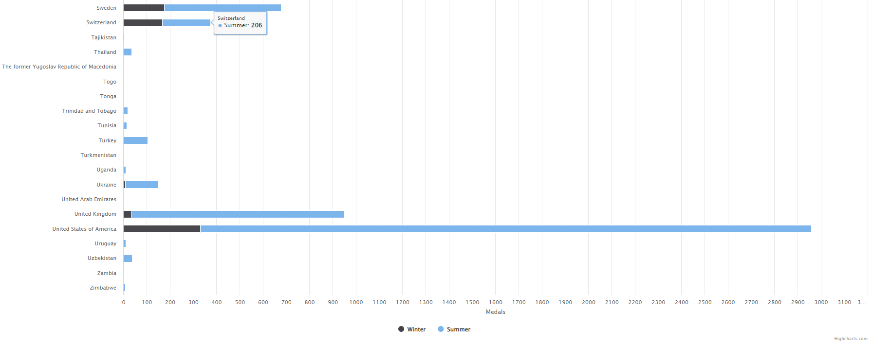
High Chart - Bar Chart: Total Wins

Slide 29
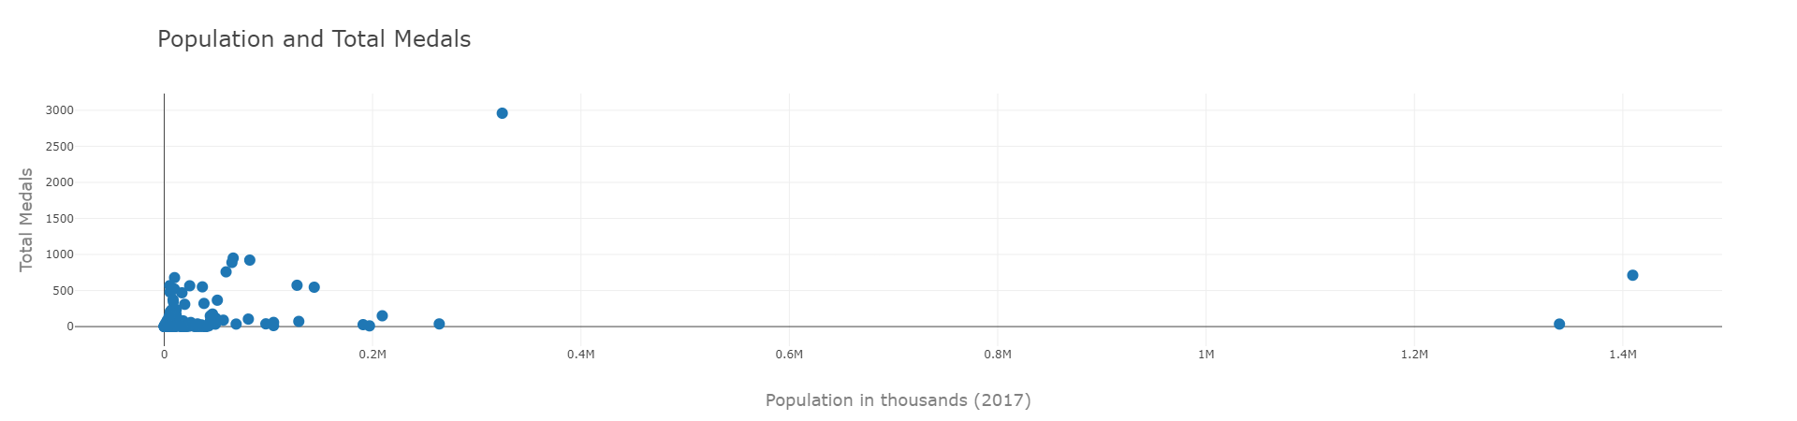
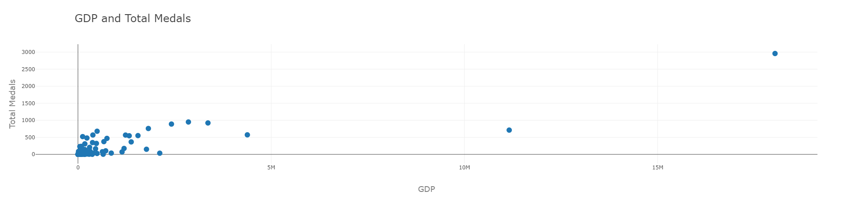
Scatter Plots - Medals With Population & GDP

Slide 30
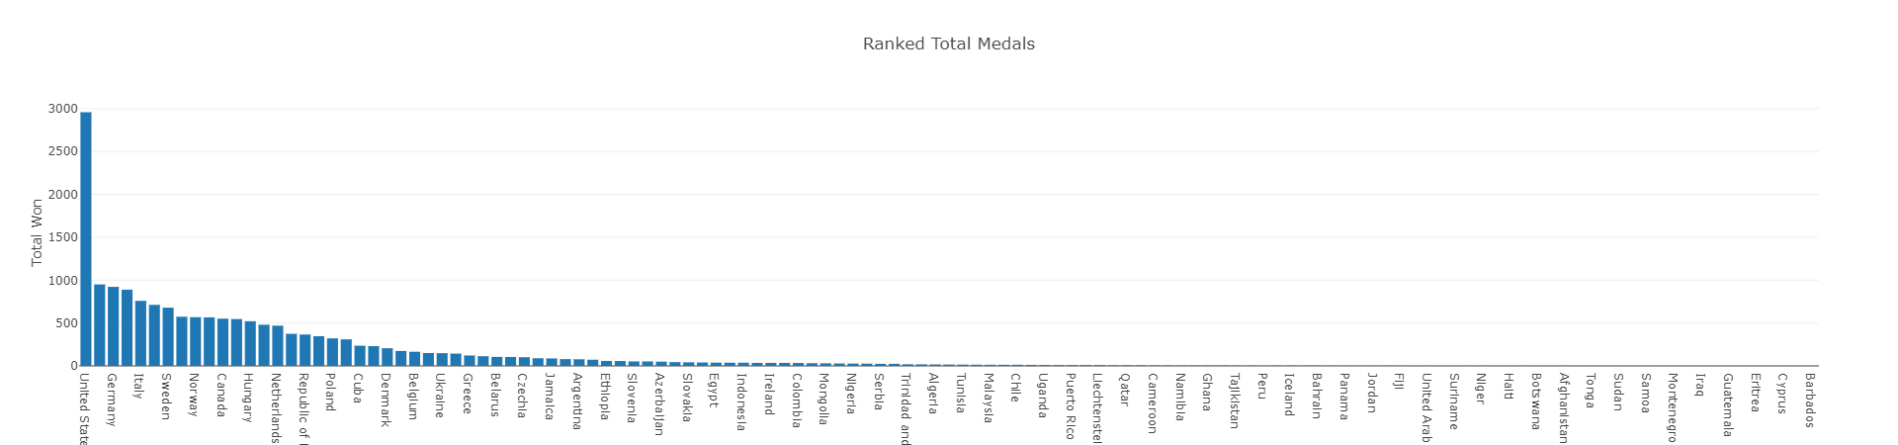
Bar Charts - Ranked

Slide 31
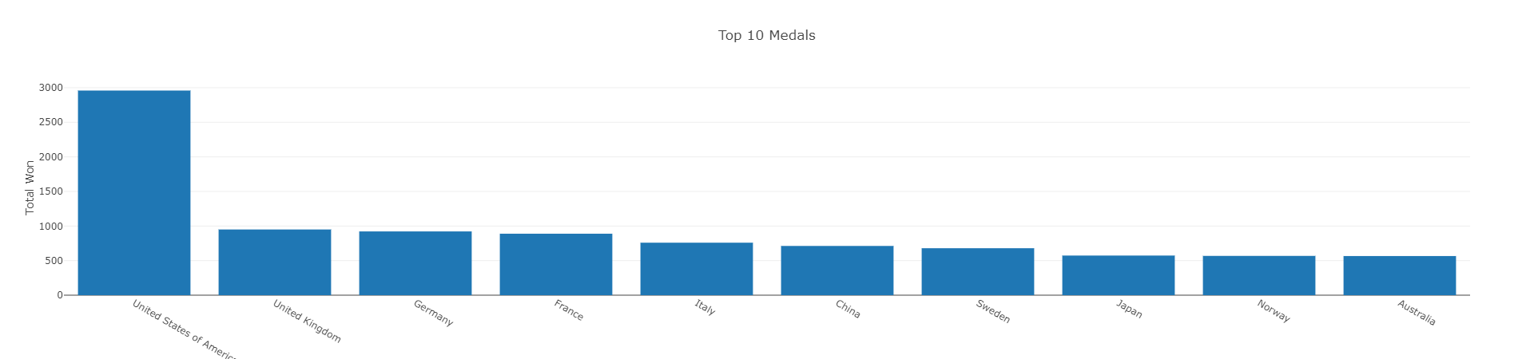
Bar Charts - Top 10

Slide 32
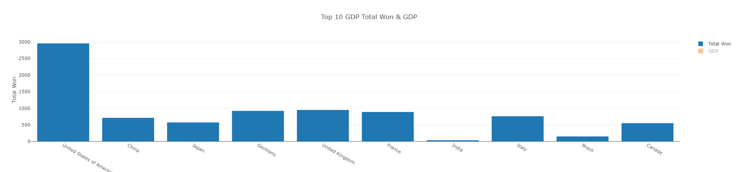
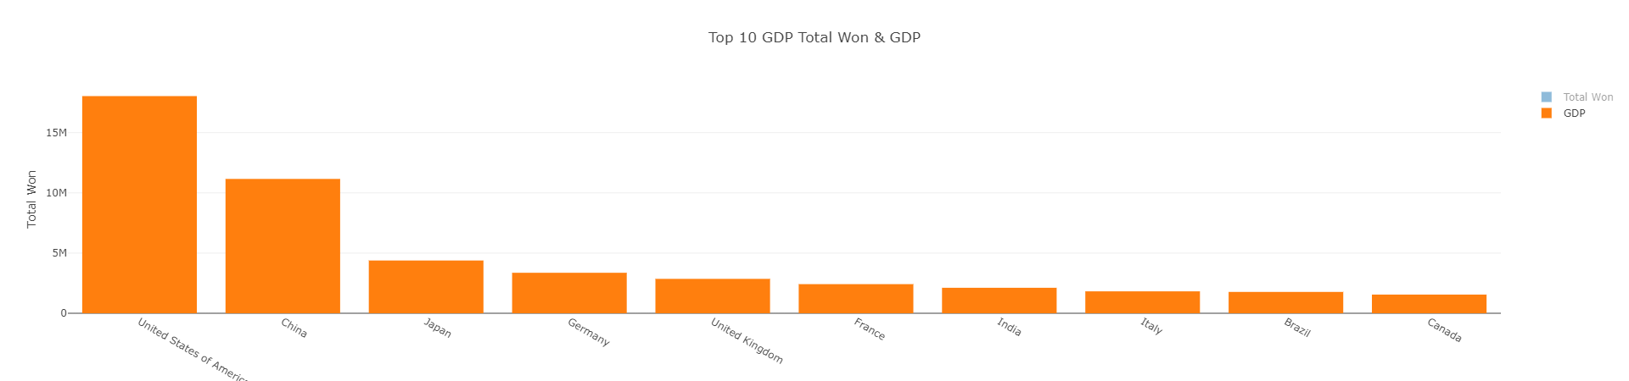
Bar Charts - GDP (2017) Top 10

Slide 33

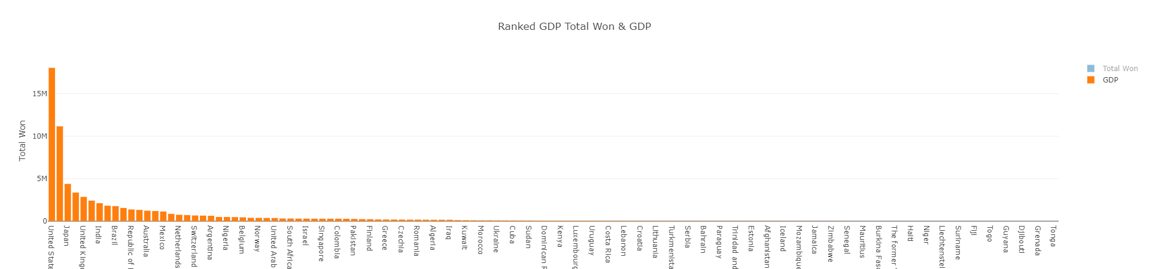
Bar Charts - GDP (2017)

Slide 34
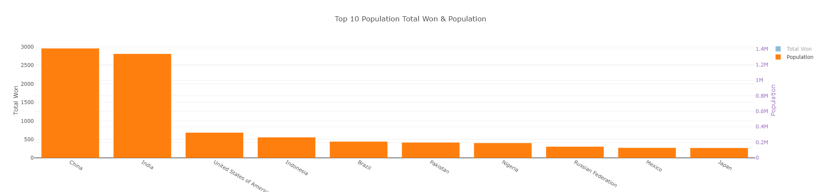
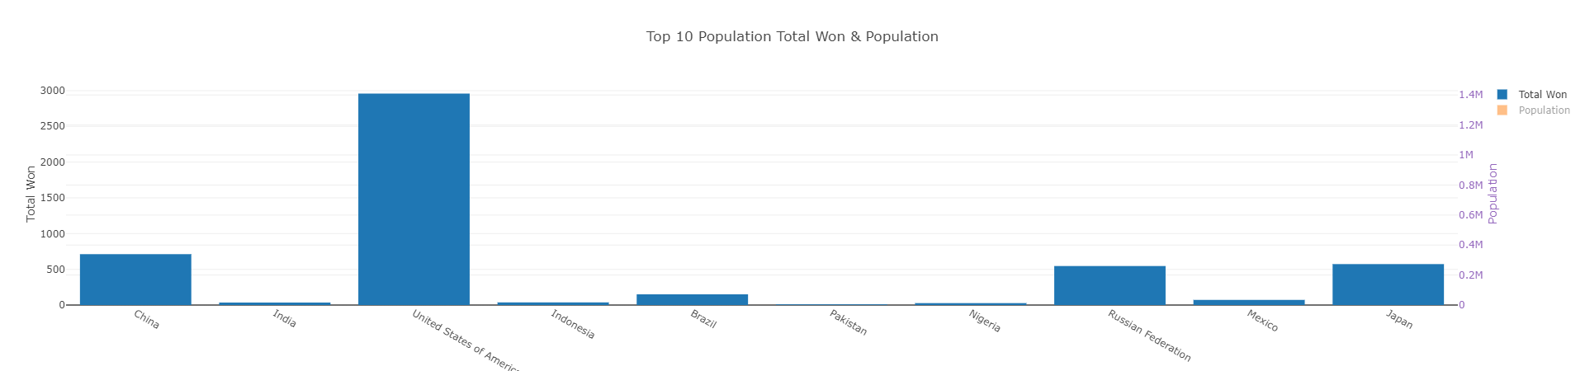
Bar Charts - Population Top 10

Slide 35
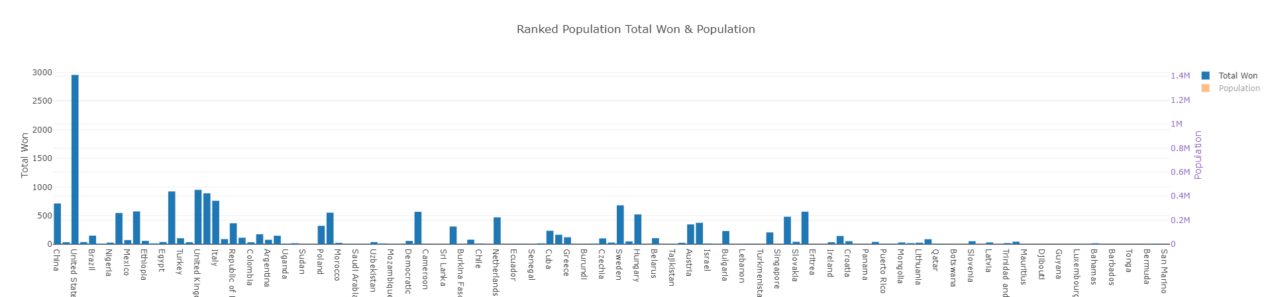
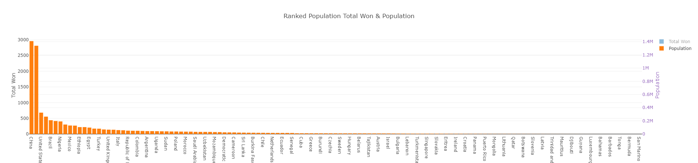
Bar Charts - Population

Slide 36

Summary
From our analysis we believe:
GDP has an effect on each countries success in the olympic games.
Population may have an effect, but much less than GDP.

Slide 37
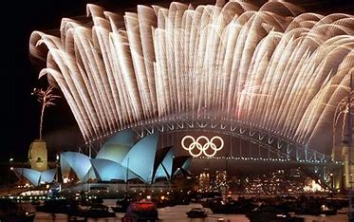

Thank You
Peregrin Ryan
Anam Khalid
Prathima
Zitarashe Okot

Slide 38
Resources
What is GDP and how is it measured? - BBC News
https://en.wikipedia.org/wiki/All-time_Olympic_Games_medal_table
https://www.kaggle.com/datasets/sudalairajkumar/undata-country-profiles

